Slide 1
Iconic mont blanc: a romantic source of inspiration
Lingua e cultura inglese I (LT) – A.A. 2019/2020
Rosalie C. Crawford – r.crawford@univda.it
Thursday, December 5th, 2019

Slide 2
Where does mont blanc end and where do i begin? Leslie Stephen, Cornhill Magazine 1873
A consideration and collation of Romantic writers and artists’ works, of their appreciation of the grandest and most terrifying aspects of Mont Blanc and the ways in which their output reflected and responded to the theories of the sublime.

Slide 3
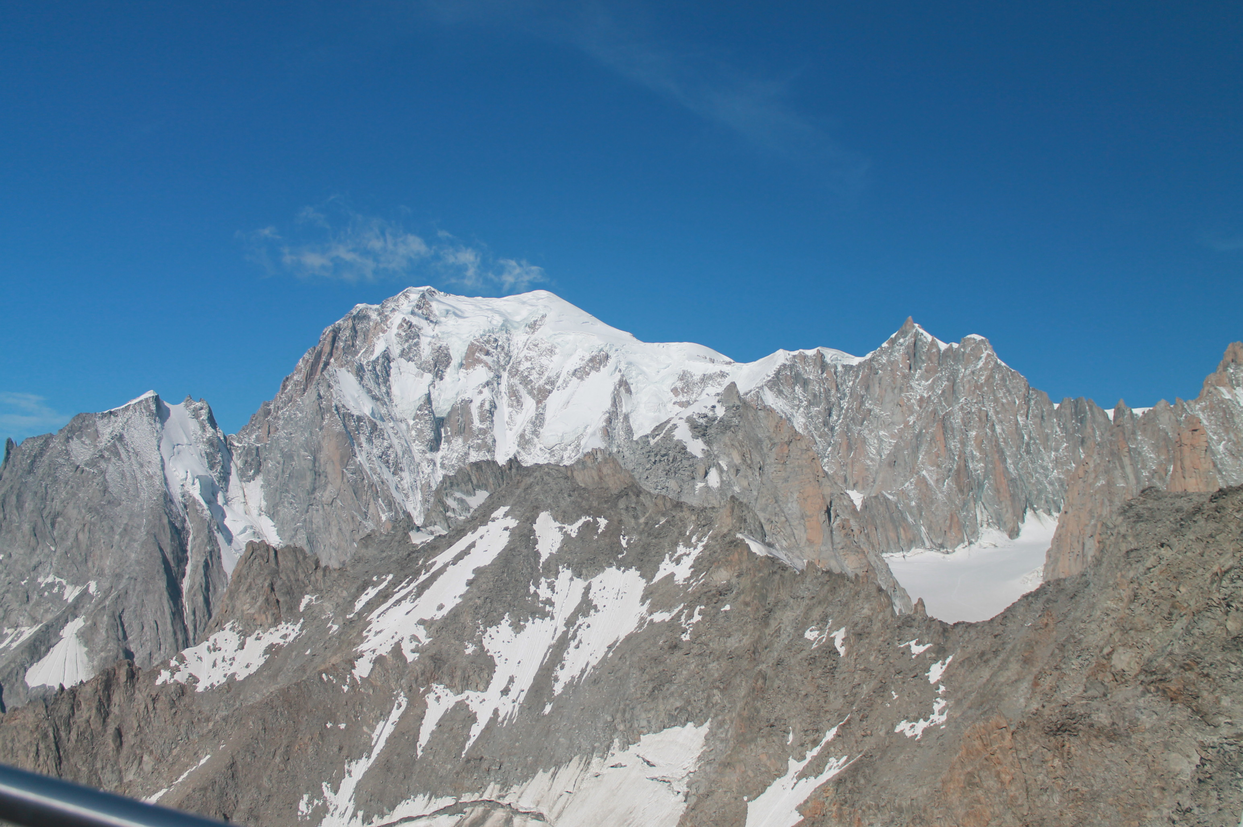

Slide 4
What’s in a mountain? What’s in a name?
Some mountains evoke religious sentiments: Mount Ararat (3,611m), Mount Sinai (2,285m)
Others rekindle great Greek myths: Mount Olympus (2,918m), Mont Parnassus (2,457m)
Alpine peaks are rarely mentioned by name prior to 1300. Monte Viso (Vesulus) was known to both Virgil and Chaucer; the Eiger occurs in a document of 1252.
Gervase of Tilbury was a wandering scholar who wrote a chronicle, Otia Imperiali (1211), in which Mont Aiguille (2,097m) is first mentioned. Charles VIII of France ordered Captain Antoine de Ville to conquer the peak in 1492
The cathedral of Aosta preserves a 16th century prayer book which recounts Saint Bernard’s expulsion of demons from Mont Joux. The Saint ordered the pagan, grotesque creatures to throw themselves into the crevasses of «Monmalet», which he described as being among the bishoprics of «Oste, Genève, Tarenthèse et Lyon».

Slide 5
The uniqueness of Mont Blanc
It was discovered and named thanks to the curiosity of scholars and scientists and the enthusiasm of travellers.
Its discovery coincides with the age of unfettered science and free research; the geographic fact is inseparable from the moral accomplishment.
For centuries, no-one named this peak or referred to it. It was devoid of consecration of a cult or literary prestige
No other place offered a field of observation as rich in geology, meteorology and physics.

Slide 6
Baptism of Mont Blanc
From 1607, it was known as Mont Maley, Mont Mallet, Montagne Maudite.
Windham organised the first pleasure trip «into the wild regions of Chamonix»
Not only was it a geographical exploration, but also an innovation: the awareness of an exceptional landscape, worthy of a visit for study or leisure
Pierre Martel, an optician from Geneva, named Mont Blanc for the first time when describing Windham and Pococke’s expedition to the Mer de Glace.
Pierre Martel «An Account of the Glaciers or Ice-alps in Savoy» London 1744.

Slide 7
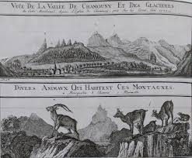

Slide 8
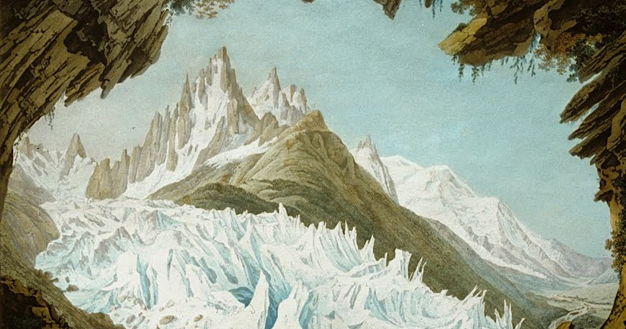
Jean-Antoine Lincke (1770-1843)

Slide 9
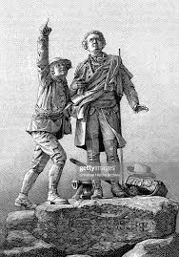
Horace Benedict de Saussure

Slide 10
The controversy of the first ascent
In 1760 De Saussure offered a «very considerable reward» for the discovery of an access route to Mont Blanc.
Several unsuccessful attempts were made by local people, trying different routes.
At 6.23 pm on 8th August 1786, Jacques Balmat, an ambitious young crystal prospector and Dr. Michel-Gabriel Paccard reached the summit by the Ancien Passage.
Marc-Théodore Bourrit published an account of the ascent in the Journal Historique et Politique, alleging that Paccard was «breathless, tired and frightened and dragged to the summit by Balmat»
Only Balmat was awarded a cash prize and a letters patent by King Vittorio Amadeo III
Paccard had Balmat sign an affadavit denying Bourrit’s allegations.
Alexandre Dumas père interviewed Balmat in 1830 and wrote a disparaging portrait of Paccard

Slide 11
Edmund Burke, A Philosophical Enquiry into the Origin of our Ideas of the Sublime and Beautiful (1757)
Burke defined the sublime as something that evokes ideas of pain, danger or terror, something terrible.
He believed that the sublime could be connected with objects and events that can be both threatening and pleasurable. Powerful scenes from nature can be sublime, like the noise of vast cataracts, raging storms and thunder
It is vastness, or “greatness of dimension”, which is “a powerful cause of the sublime”.
Another source of the sublime is what Burke calls infinity, where the eye is not able to “perceive the bounds” of something, or “see an object distinctly”, and this gives rise to a “terrible uncertainty of the thing” perceived.
The aesthetics of the sublime revolved around the relationship between human beings and the grand or terrifying aspects of nature.
Immanuel Kant, Observations on the Feeling of the Beautiful and Sublime (1764, Engl. tr. 1799); Critique of Pure Reason (1781, Engl. tr. 1838)
Whereas the beautiful is limited, the sublime is limitless (CoPR)

Slide 12
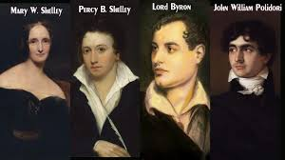
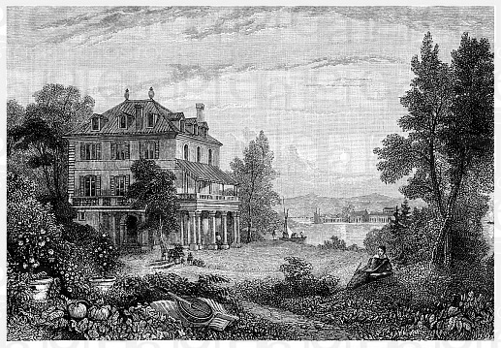
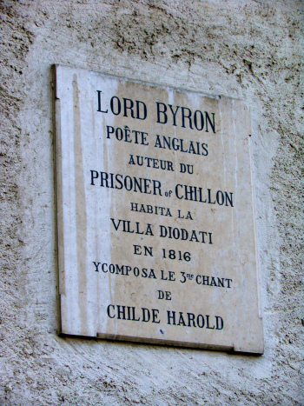
Summer 1816
Three major works were conceived on the shores of Lake Leman in Switzerland in the summer of 1816: Mary Shelley’s gothic novel Frankenstein, : the third canto of Lord Byron’s romance poem Childe Harold’s Pilgrimage; and Percy Bysshe Shelley’s ‘Mont Blanc: Lines Written in the Vale of Chamoni’

Slide 13
Mary Shelley: from experience to literature
The journey across the French border and into Switzerland involved travelling through bleak, wintry landscapes. As Mary recorded afterwards in her travel volume:
Never was a scene more awefully desolate. The trees in these regions are incredibly large, and stand in scattered clumps over the white wilderness; the vast expanse of snow was chequered only by these gigantic pines, and the poles that marked our road: no river or rock-encircled lawn relieved the eye, by adding the picturesque to the sublime’..
In her 1831 preface to the novel, Mary Shelley describes her heightened consciousness of terror at the Villa Diodati
When I placed my head on my pillow I did not sleep, nor could I be said to think. My imagination, unbidden, possessed and guided me, gifting the successive images that arose in my mind with a vividness far beyond the usual bounds of reverie. I saw – with shut eyes, but acute mental vision – I saw the pale student of the unhallowed arts kneeling beside the thing he had put together. I saw the hideous phantasm of a man stretched out, and then, on the working of some powerful engine show signs of life and stir with an uneasy, half-vital motion …could be transformed into brilliant and inspirational creativity:

Slide 14
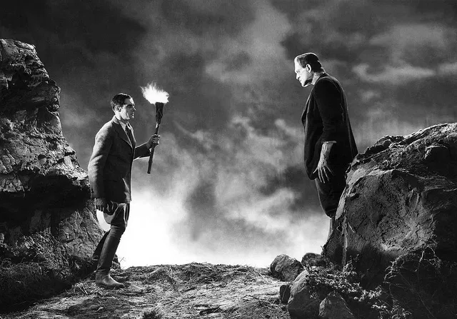
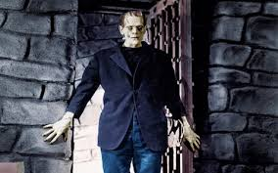
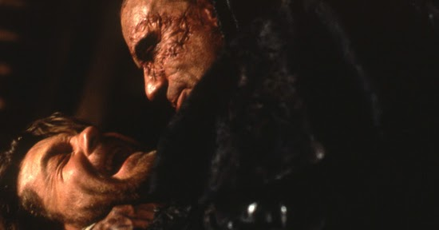

Slide 15
Mary Shelley’s «Frankenstein or the Modern Prometheus»
Chapter 7: «I wept like a child. Dear mountains! How do you welcome your wanderer?»
Mont Blanc stirs intense emotions in Victor. Its sublimity is not merely described, but is expressed in Victor’s reaction to the storm.
«William, dear angel! This is thy funeral, this thy dirge!»
Chapter 9: Victor is so overcome by the pure majesty of his surroundings, he is unable to describe his emotional state,which goes from sadness, to awe, to happiness and finally to fear.
Chapter 10:
Mont Blanc represents an inexorable connection between Victor and his creation. Both of them show respect and affection for nature, admiring its beauty and sublimity, its sights and sounds. Mont Blanc is chosen as a safe destination, a sanctuary. In times of difficulty, both of them isolate themselves.

Slide 16
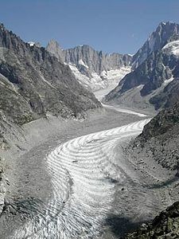
The Mer de Glace
The surface is very uneven, rising like the waves of a troubled sea, descending low, and interspersed by rifts that sink deep. The field of ice is almost a league in width, but I spent nearly two hours in crossing it. The opposite mountain is a bare perpendicular rock. From the side where I now stood Montanvert was exactly opposite, at the distance of a league; and above it rose Mont Blanc, in awful majesty. I remained in a recess of the rock, gazing on this wonderful and stupendous scene.

Slide 17
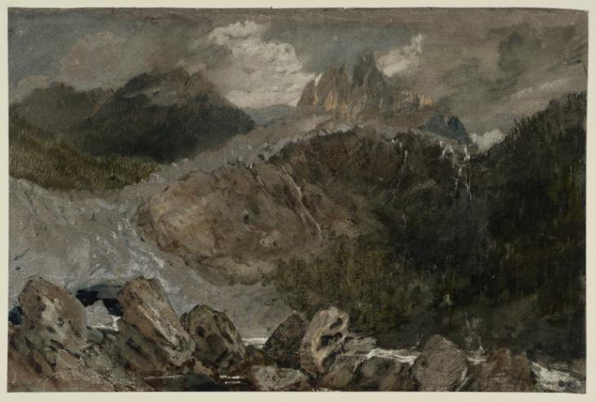
J.W.M. Turner St Gothard and Mont Blanc Sketchbook1802
As Turner reached the glaciers of the Mont Blanc chain, his drawings pulsed with a different energy altogether. The jagged forms of ice-flows, scattered rocks, dead or twisted trees set up discontinuities and conflicting patterns of diagonals, studied in their strangeness and savagery.
No pictorial conventions can contain such things, and Turner threw them away, becoming the first modern artist

Slide 18
Snow Storm: Hannibal and his Army Crossing the Alps

Slide 19
Percy Bysshe Shelley, Mont Blanc: Lines Written in the Vale of Chamouni
In Parts I and II, Percy addresses the Arve, whose source is in the bowels of Mont Blanc, and explores the nature of reality and the origins of ideas.
He distinguishes between the “individual mind” (line 7, ‘feeble brook’) and the “Universal Mind” in Part II (Ravine of Arve) and the relationship of the poet’s individual mind to the Universal Mind (of which all individual minds are part)
This relationship is possible through ”Power” (lines 16-19), a dynamism which is embodied “in likeness of the Arve” (river, as opposed to the ‘feeble brook’).
The description of the Arve becomes more complex, a mysterious, unsettling landscape
“Wild thoughts” (l.43), after drifting in external reality, rest “in the cave of the witch Poesy (l.43)

Slide 20
Mont Blanc part III
Shelley keeps ascending towards the principles of nature and poetry.
The description of Mont Blanc passes from «still, snowy, serene» to «rude, bare, and high, ghastly, and scarred and riven», terrifyingly ugly.
Like in part II, Shelley identifies, and associates, silence and eternity again in part III. The silent wilderness instils doubt and weakens his faith which prevents him from being reconciled with Nature.
Only wise men like poets and philosophers, can interpret and discern the superior voice and say whether Nature is benevolent or manevolent.
Unlike Coleridge, Shelley’s «religion» is his poetry, his writing.
He has to define the specific quality of «power»

Slide 21
Mont Blanc parts IV & V
Power dwells in tranquility
Glaciers have a devastating effect on everything (refuges, beasts, insects) that surrounds them.
The glaciers upheaving and dragging movement leave space only for «raging torrents» (the power??)
The poem ends with an unanswered epistomolgical question which summarises Kant’s aesthetics of the sublime. Man’s greatness can’t be physical, it has to be ethical. The task of poetry is to interpret «power» which is present both in nature and the poet’s mind.
«And what were thou, and earth and stars and sea,
If to the human mind’s imaginings
Silence and solitude were vacancy?»

Slide 22
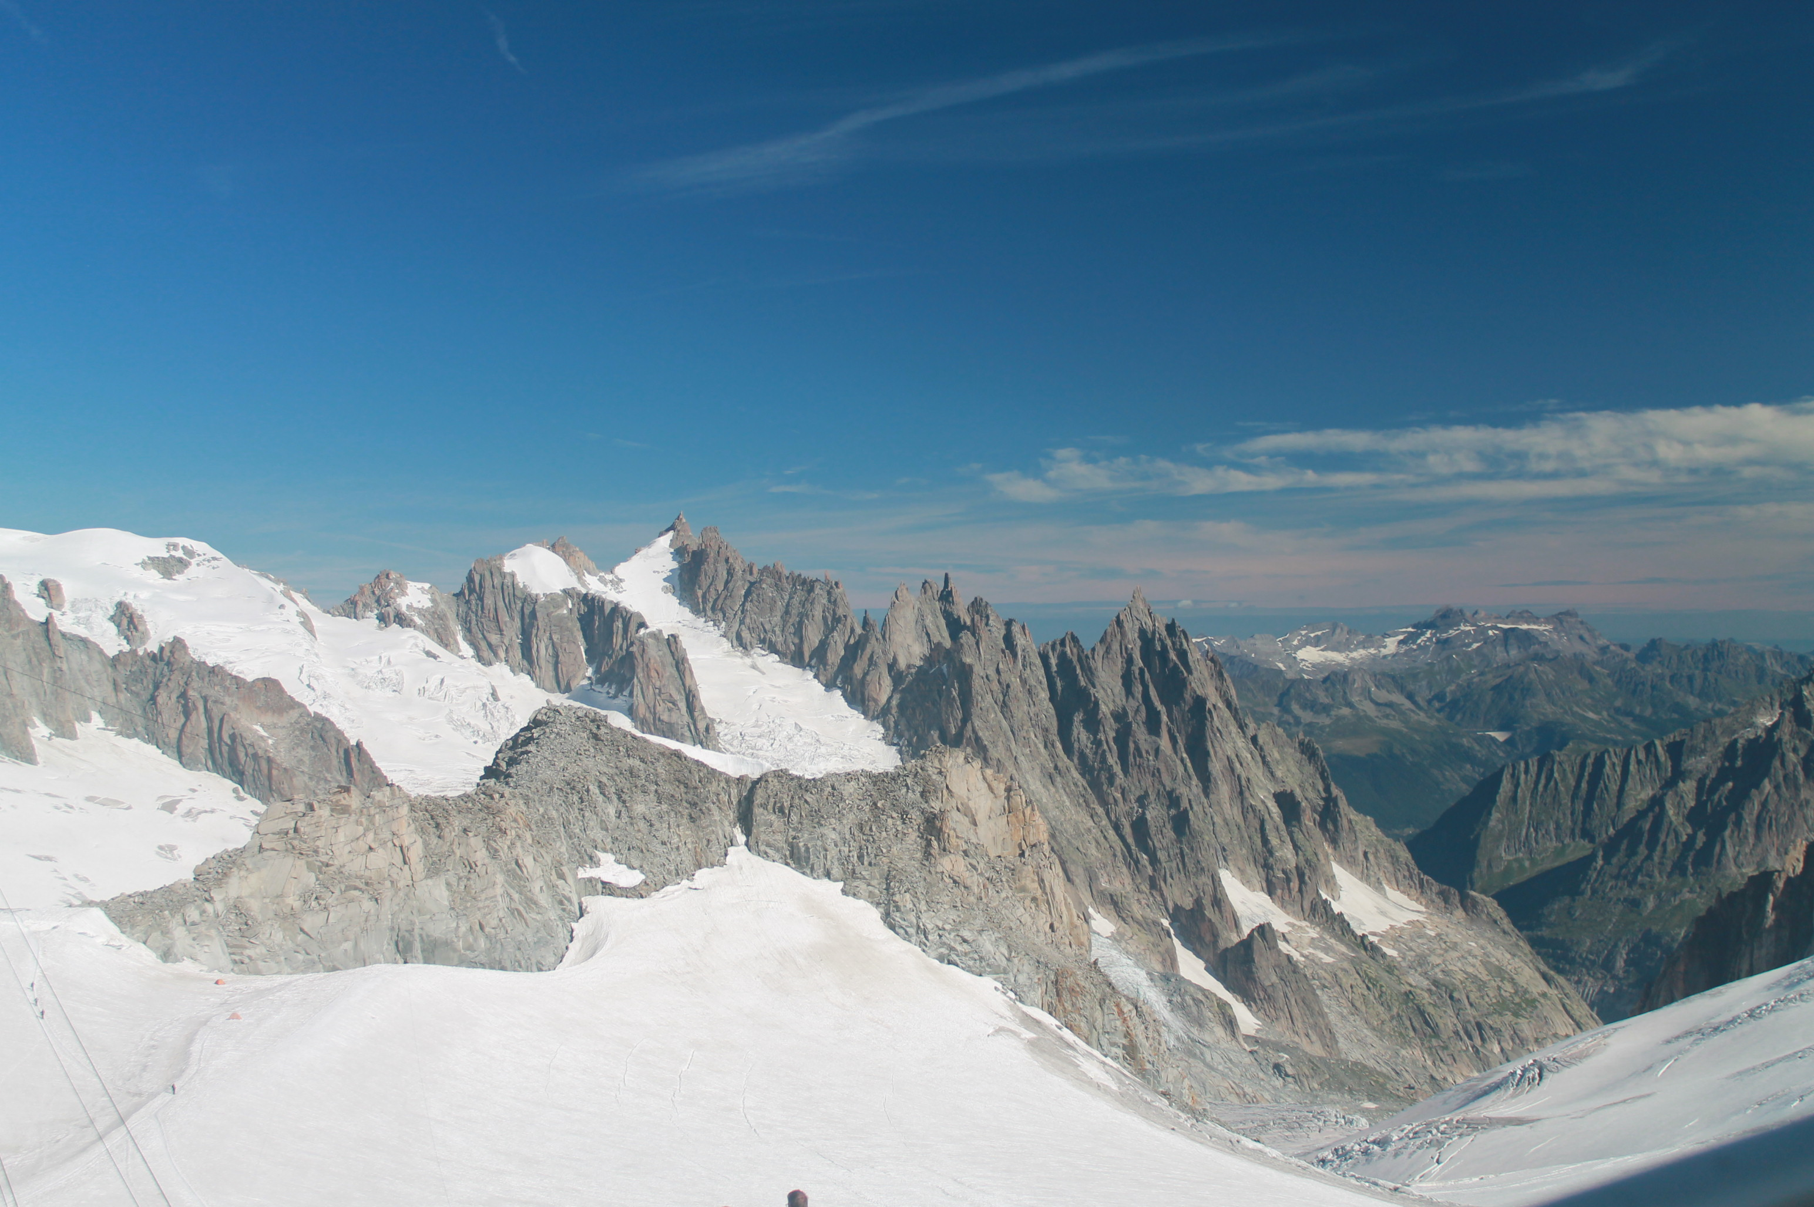

Slide 23
Reflections…
The speaker in «Mont Blanc» listens to the mountain's "voice" to find the "truth" that should be used to guide humanity. This relationship to the mountain is not unlike that of Victor, who looks to the immutable Mont Blanc as a source of help and solace in his darkest hours. The chief difference between Victor and the speaker of Percy Shelley's poem is that the former does not truly understand nature (exemplified in his perversion of natural order by creating the Monster), while the latter is a poet devoted to nature, who allows the mountain to teach him.
Like J M W Turner’s watercolour sketches of the area around Mont Blanc, which depict human figures dwarfed by vast, over-hanging precipices and barren swathes of ice, Shelley’s visionary landscape is forbidding and austere. In the absence of God, the poem seems to suggest, mountains have meaning solely as a result of the animating power of the human imagination.

Slide 24
S.T. Coleridge ‘Hymn Before Sun-rise, In the Vale of Chamouni’ 1802
Coleridge never saw Mont Blanc. His source was a poem by a German poetess Friedrike Brun.
As an expression of an image of transcendence, Mont Blanc is not a symbol of the supreme being, but a symbolic medium that allows access.
The point of departure for this ascending symbolism is the gloomy forest at the foot of the mountain. Then the mountain’s snowy peaks become crystal. Solid, transparent crystal is the intermediary step in an ascent towards the abstract and ecstasy.
Mont Blanc disappears because the thinking observer has become one with the mountain and can admire the house of the Creator and be in contact with the Supreme Being.
Mont Blanc is the intermediary between sky and earth, creature and creator, a carrier of earthly words that can reach God

